Slide 1
PRIVILEGED ACCOUNT SECURITY

Slide 2


PrivilegOVANÉ ÚČTY jsou všude

Slide 3




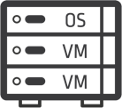
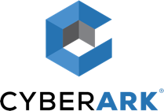
PrivilegOVANÉ ÚČTY - “KLÍČE K VAŠEMU it”
PrivilegOVANÉ ÚČTY
“Keys to the IT Kingdom”
ExternÍ ÚTOČNÍK
INTERNÍ HROZBA
Provides Proactive
Protection and Detection

Slide 4
TYPICKÝ PRŮBĚH ÚTOKU

Slide 5

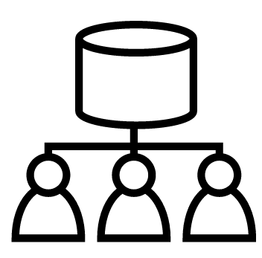
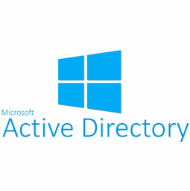

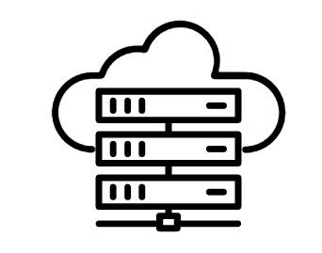



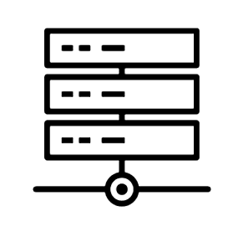



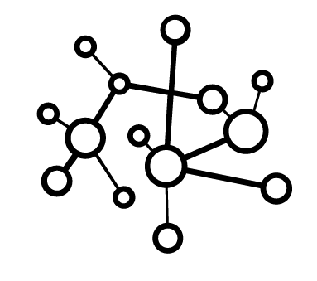


Zaslání phishing emailu
Vynesení citlivých dat
Command and control
Golden ticket
Segmented Network
Query AD
Open
Access
Other WorkStations and Servers
Cloud
App Server
Cloud
Patient DB
Active Directory
Network Map
Interactive Session
Dump Credential
Use Credential
On-prem
App Server
On-prem
Patient DB
HR User
Získání přístupu do sítě
a mapování
Laterální pohyb na úroveň
Domain Admin
Získání přístupu k datům
a jejich zcizení
Notes:
We start with phishing, attack an HR employee, gaining access, use Active Directory to learn about the environment and get a lay of the land.
Escalate local privileges, dump stored credential and find local admin that are the same for all machines in that department .
Use SMB to move laterally to another machine in the department and find domain admin logged into another box.
Rinse and repeat we dump creds, and gain domain admin, and continue to execute domain sync and gain golden ticket in the domain.
Use the DA to pivot to segmented network, access DB server and exfiltrate all of their patient information

Slide 6




KROK1: Získání přístupu do sítě a mapování
Zaslání phishing emailu
Útočník zasílá cílený phishing email
Uživatel otevírá přílohu emailu a stahuje škodlivý kód na koncové stanici
Škodlivý kód vyvolá standardní komunikaci s AD a získá informace o doméně
Z těchto dat vytvoří základní mapu síťové infrastruktury – uživatele, přihlašování, oprávnění přístupu,…
Query AD
Active Directory
HR User
Network Map
>echo “Největší zranitelností je stále uživatel. Získání přístupu do IT infrastruktury je i pro hackera se základním skillem relativně jednoduché…” > important.txt
Notes:
We start with phishing, attack an HR employee, gaining access, use Active Directory to learn about the environment and get a lay of the land.
Escalate local privileges, dump stored credential and find local admin that are the same for all machines in that department .
Use SMB to move laterally to another machine in the department and find domain admin logged into another box.
Rinse and repeat we dump creds, and gain domain admin, and continue to execute domain sync and gain golden ticket in the domain.
Use the DA to pivot to segmented network, access DB server and exfiltrate all of their patient information

Slide 7
Krok 2: Laterální pohyb na úroveň Domain Admin
Po získání přístupu na lokální stanici se útočník snaží “posouvat“ dále v síti
Provádí lokální scan pro načtené přihlašovací údaje – local admin, domain user,…
Laterálním pohybem se posouvá na všechny dostupné stanice a servery a získává další přístupy dokud…
…nezíská přístup na úrovni domain admin – s pomocí zneužití zranitelnosti Golden Ticket se nyní může dostat kamkoliv
Command and control
Golden ticket
Open
Access
Other WorkStations and Servers
Interactive Session
Dump Credential
Use Credential
>echo “Kompletní převzetí kontroly nad doménou je pro zkušeného hackera otázkou několika hodin…” > important.txt
Notes:
We start with phishing, attack an HR employee, gaining access, use Active Directory to learn about the environment and get a lay of the land.
Escalate local privileges, dump stored credential and find local admin that are the same for all machines in that department .
Use SMB to move laterally to another machine in the department and find domain admin logged into another box.
Rinse and repeat we dump creds, and gain domain admin, and continue to execute domain sync and gain golden ticket in the domain.
Use the DA to pivot to segmented network, access DB server and exfiltrate all of their patient information

Slide 8

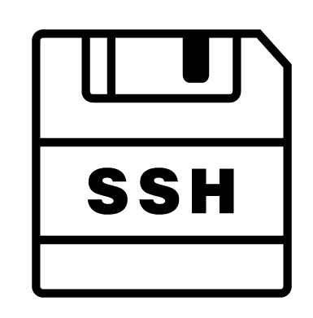

Krok 3: Získání přístupu k datům a jejich zcizení
Zcizení citlivých dat
Nyní má útočník plnou moc nad doménou a prostředím cíle
Jako domain admin se útočník může bez obav připojit na jakýkoliv backend server – například interní web s přístupem do databáze
Na web serveru je konfigurační XML soubor s přístupy k databázi – pro útočníka velmi snadná cesta, jak se dostat k citlivým datům
Případně lze získat přístup ze stanice vývojáře, kde je uložený SSH klíč k připojení ke cloud app serveru a cloud databázi s citlivými daty…
…v takovém případě má pomocí SSH klíče a dat z XML kompletní přístup ke cloud i on-premise databázím
Other network WorkStations and Servers
Segmented Network
Cloud
App Server
Cloud
Patient DB
>echo “Získání přístupu na úrovni domain admin umožní útočníkovi “legitimní“ přístup kamkoliv v rámci IT infrastruktury – on-premise i cloud” > important.txt
On-prem
App Server
On-prem
Patient DB
Notes:
We start with phishing, attack an HR employee, gaining access, use Active Directory to learn about the environment and get a lay of the land.
Escalate local privileges, dump stored credential and find local admin that are the same for all machines in that department .
Use SMB to move laterally to another machine in the department and find domain admin logged into another box.
Rinse and repeat we dump creds, and gain domain admin, and continue to execute domain sync and gain golden ticket in the domain.
Use the DA to pivot to segmented network, access DB server and exfiltrate all of their patient information

Slide 9
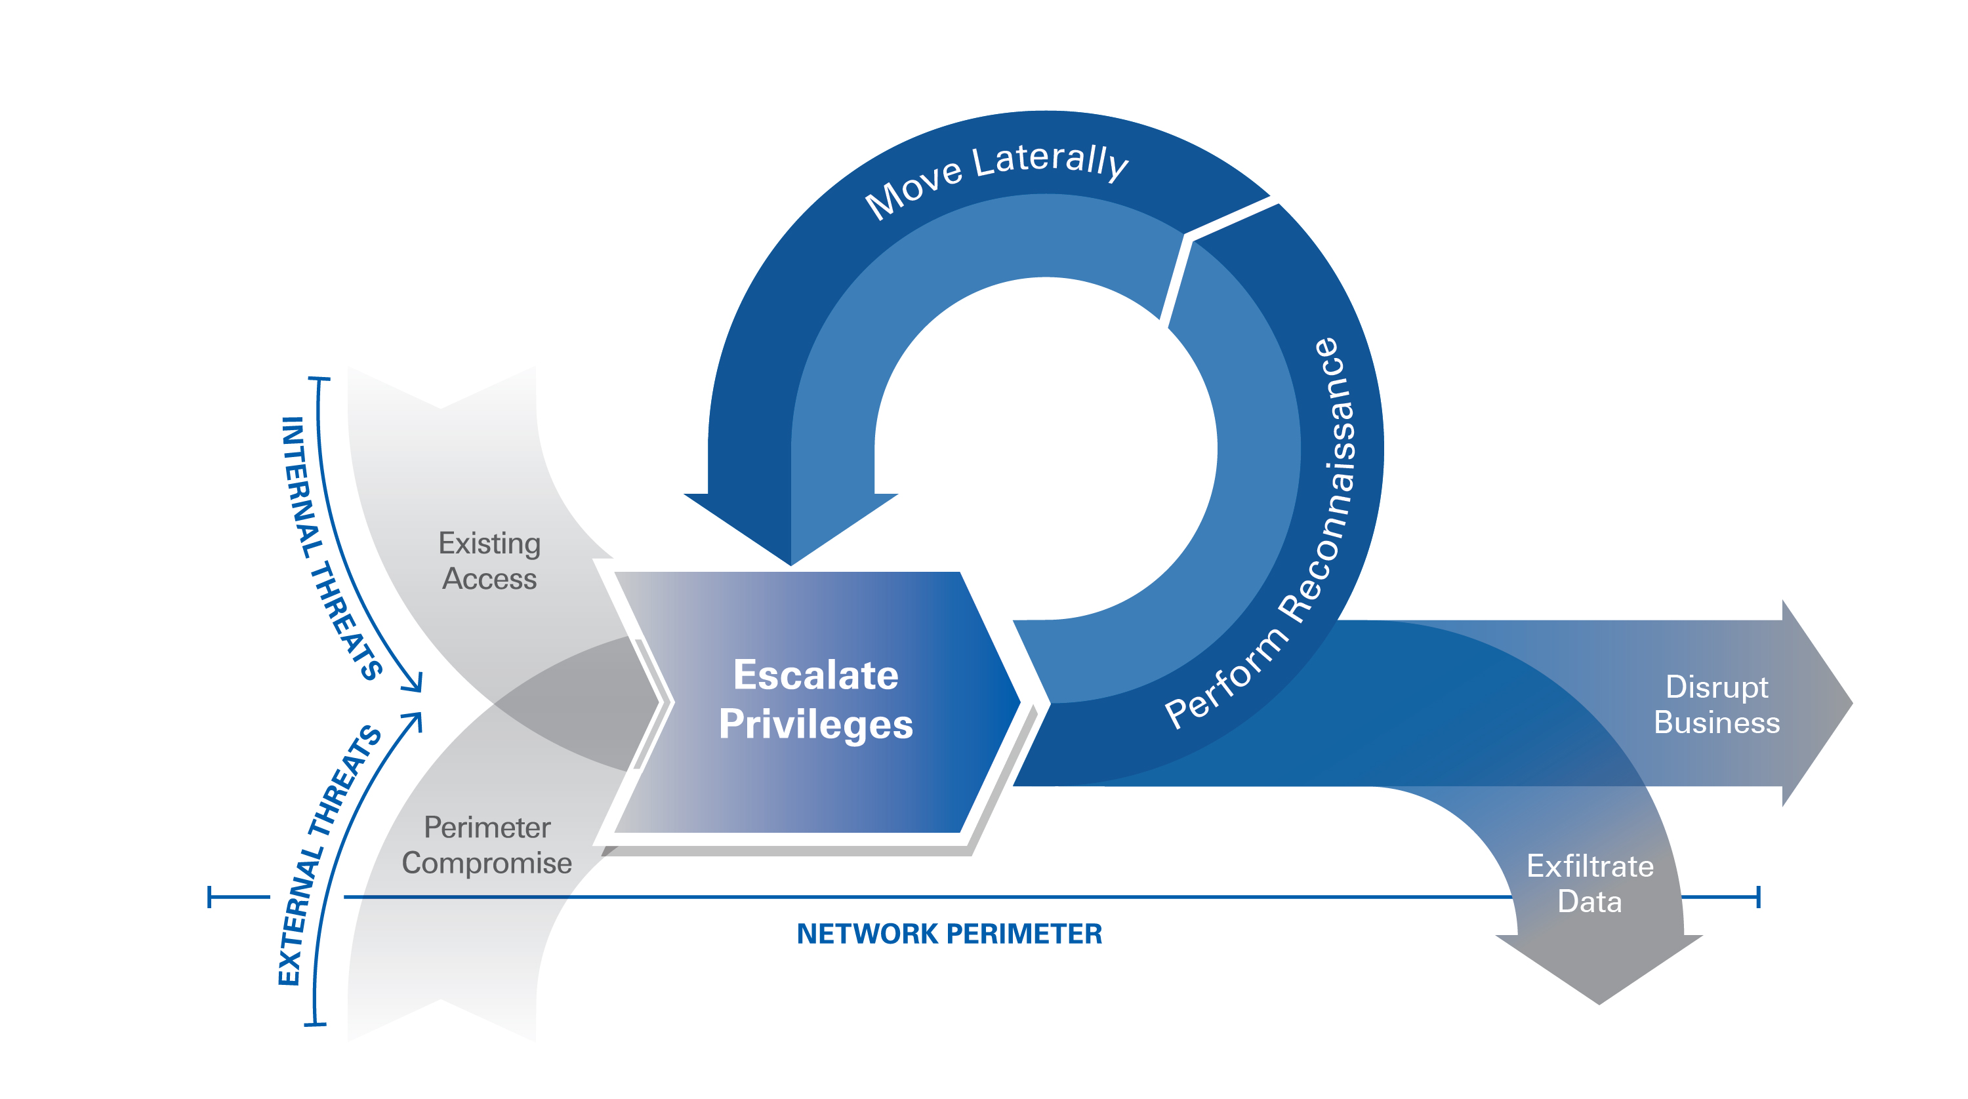
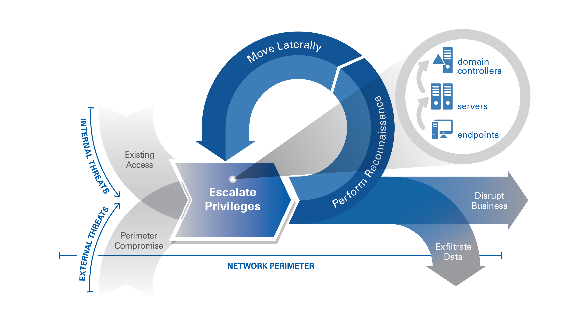
Eskalace privilegií umožňuje snadný přístup k vašim zdrojům

Slide 10


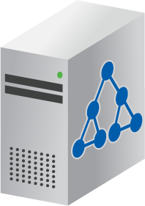


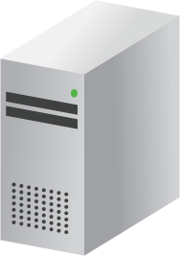


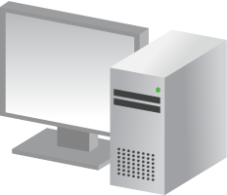

ESKALACE OPRÁVNĚNÍ – AŽ NA ÚROVEŇ DOMAIN ADMIN

Slide 11
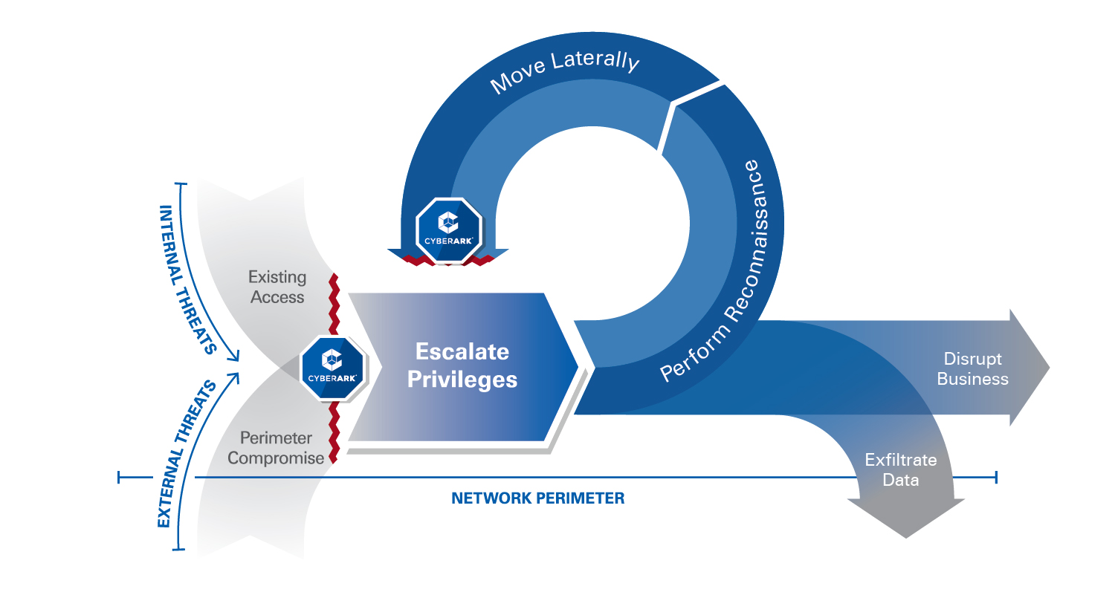
CyberArk chrání na více úrovních

Slide 12



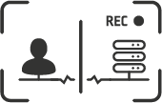

Komplexní ochrana Privilegovaných účtů
Real-time monitoring používání všech privilegovaných účtů
Řízení přístupu
k privilegovaným
účtům
Řízení relací
Izolace a nahrávání
Řízení oprávnění
Uložit a rotovat
Privilegovaná hesla
a SSH klíče
Prevence útoků
a kontrola privilegovaných přístupů
Oprávnění
uživatelů
na koncových systémech
Notes:
Organizations need to look to lock down the access both human and non-human users have to critical systems and applications. This involves managing password and SSH key policies and limiting access to only authorized users by implementing strong controls over the privileged account credentials.
You should start by identifying and discovering all your privileged accounts within your environment. Most organizations have orphaned privileged accounts or will forget to remove a privileged account after an employee leaves the business. They also have no clue as to how many service accounts they have under management, this really needs to be managed effectively to be as secure as possible. You should then look to place each privileged credential in a secure digital vault and to provide individual access to the passwords and SSH keys. Add to that multi-factor authentication for users to access credentials within the vault. This creates strong password policies and enforces individual accountability for each action taken using the credential at any particular time.
Privileged sessions also need to be isolated to provide a single control point and to prevent malware from jumping from an administrator workstation to a server that might be holding sensitive data. Session recording adds to that baseline of accountability and creates a full audit trail of privileged activity that cannot be altered.
Organizations also need to look to manage accounts by the “least privilege principle.” They should limit the scope of privileges for each user, so each user has privileges to do his/her job, but no quote unquote “extra” privileges that could be mistakenly used to inflict damage on the network or maliciously used to cause damage.
You should use admin accounts for administrative tasks ONLY. Delegate only those permissions needed for a user to do their job. Restrict application accounts to “least privilege” as well – again – so not just human users here, so for example, not allowing applications to have domain administrator privileges..

Slide 13
Privileged Account Security Solution
Notes:
Now that we have reviewed the Shared Technologies, lets now shift gears and go into the Privileged Account Security Solution and review each product
<click>

Slide 14
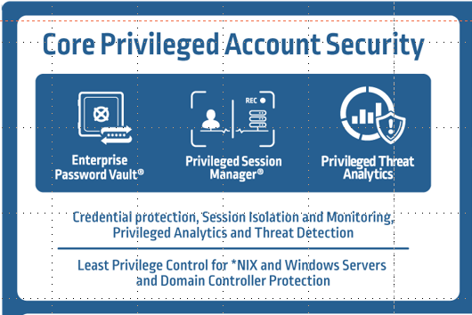
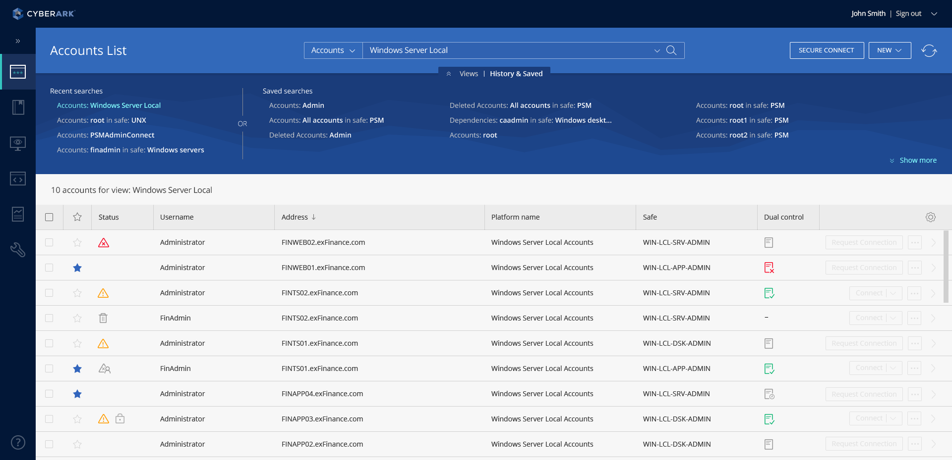
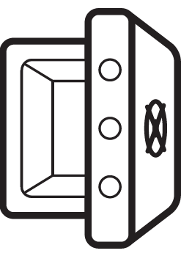



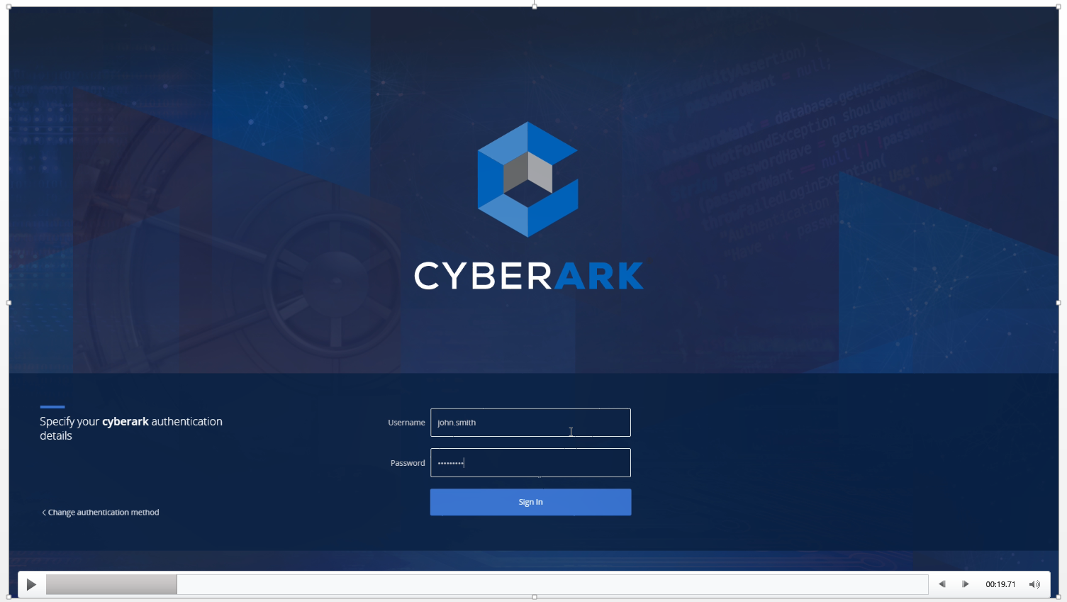


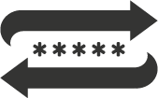
Zabezpečení a správa přihlašovacích údajů
ENTERPRISE
RESOURCES
SERVERS
MAINFRAMES
Digital Vault – vysoce zabezpečené úložiště přihlašovacích údajů
Silná autentizace + striktní oddělení přístupových oprávnění
Rotace hesel/SSH klíčů - centrální politika pro všechny privilegované účty
Široká škála podporovaných systémů – out-of box
Auditní záznam o každém použití privilegovaného účtu
DATABASES
APPLICATIONS
NETWORK DEVICES
SECURITY APPLICANCES
PASSWORD ROTATION
SECURE
STORAGE
CYBERARK WEB PORTAL
WEBSITES/
WEBAPPS
CLOUD INFRASTUCTURE
Notes:
The CyberArk Core PAS Solution secures, rotates and tracks the use of privileged passwords and SSH keys. Using this product, organizations can ensure that only authorized users are able to access privileged credentials used to login into a variety of systems on-premises, in the cloud and in ICS environments. Using Master Policy, administrators can set credential length, strength and rotation policies, as well as determine which user groups may access what credentials.
Let’s look at how this works from the user’s perspective:
When a privileged user needs to access an enterprise resource, he or she he must first retrieve the password from CyberArk. To do this, the user authenticates to the CyberArk Web Portal. Note that CyberArk supports a variety of authentication methods, including LDAP, RADIUS, RSA SecurID, Duo, SAML, and more.
(CLICK) Once in the web portal, the user will select the needed privileged account. Note here, the user can only see accounts that he or she is entitled to; the user cannot see any others.
(CLICK) Upon selecting the needed account, CyberArk will retrieve the necessary password or SSH key from the digital vault. The user can either copy the credential into a remote access tool, write the password down (as may be needed in the event of a system outage) or select a “transparent connect” option, (CLICK) which automatically establishes a remote connection directly from the Web Portal.
These products help organizations limit privileged account access to only authorized users and audit who accessed what accounts. This is particularly valuable for shared accounts, as CyberArk track which individual used what shared account at what time.
(CLICK) Questions to ask when discussing with a prospect include:
How do you granularly control privileged account access?
How do you audit the use of privileged and shared accounts?
<click>

Slide 15

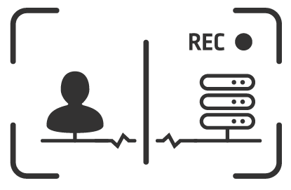

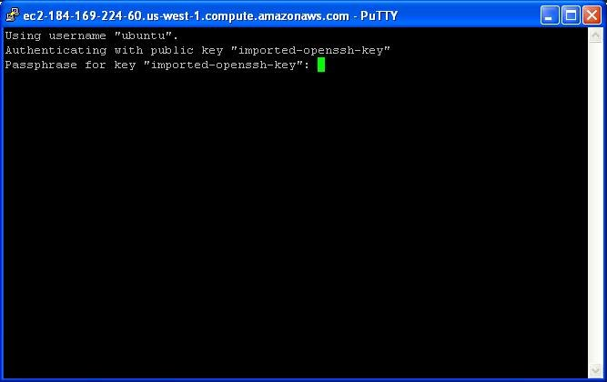
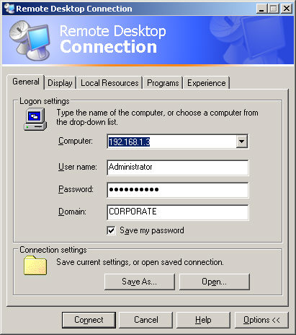
Session isolation, monitoring and recording
ENTERPRISE
RESOURCES
Blokuje před infiltrací malware
Blokuje únik přihlašovacích údajů
SERVERS
MAINFRAMES
Izolace relací na citlivé IT systémy – bezpečný přístup pro interní i externí subjekty
Komplexní monitoring vybraných relací – auditní záznam, včetně vidonahrávky
Automatické vyhodnocení jednotlivých relací na základě jejich rizika
DATABASES
APPLICATIONS
NETWORK DEVICES
SECURITY APPLICANCES
CYBERARK WEB ui – nebo – preferovaný tool
WEBSITES/
WEBAPPS
CLOUD INFRASTUCTURE
Notes:
Next, the CyberArk Core PAS Solution provides session isolation, monitoring and recording. The solution acts as a secure jump server, isolating privileged users sessions and establishing a single point of control from which security and audit teams can then monitor, record, suspend and terminate sessions, if necessary. Let’s take a look at how it works:
Before initiating a privileged session, a user will first log in to CyberArk and select the needed account. Users can log in to CyberArk either through our web portal or through their preferred native tools, such as RDP, PuTTy, or others.
(CLICK) Upon selecting or defining the needed account, the solution validates the user’s permissions, retrieves the privileged account password or SSH key from the Digital Vault and sends it to the target system for authentication.
(CLICK) PSM then establishes a secure, isolated remote session and records all activity during that session. Session recordings are securely stored in the Digital Vault so that users are unable to edit their audit histories.
Notable here, if a user is part of an AD group that is permitted to access certain Linux or Unix systems but an account has not yet been created for that user on those systems, the solution can create the account on the fly. This automated Unix and Linux account provisioning, based on AD policy, can help save time and effort for Unix and Linux operations teams.
Beyond pure feature/functionality, this secure architecture serves two additional purposes (CLICK):
First, because the user never directly connects to target systems and the Core PAS server is locked down, any potential malware on a user’s machine cannot jump to critical systems.
Second, because credentials are retrieved by the solution and sent directly to the target system, neither the end user nor the user’s machine is exposed to the credential. Any keylogging malware on the endpoint would be ineffective, as the user never types in the target credentials. And, since users do not see the credentials, they are unable to bypass controls to directly access target systems.
(CLICK) Questions to ask when discussing with a prospect include:
How do you isolate sensitive assets from the rest of the infrastructure while still enabling necessary access?
How do you track user activity during privileged sessions?
How would you benefit from no longer needing to manually provision privileged Unix and Linux accounts?
<click>

Slide 16

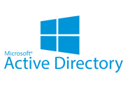

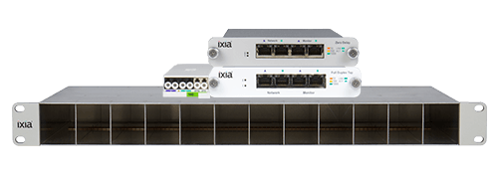


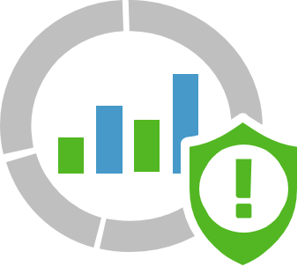
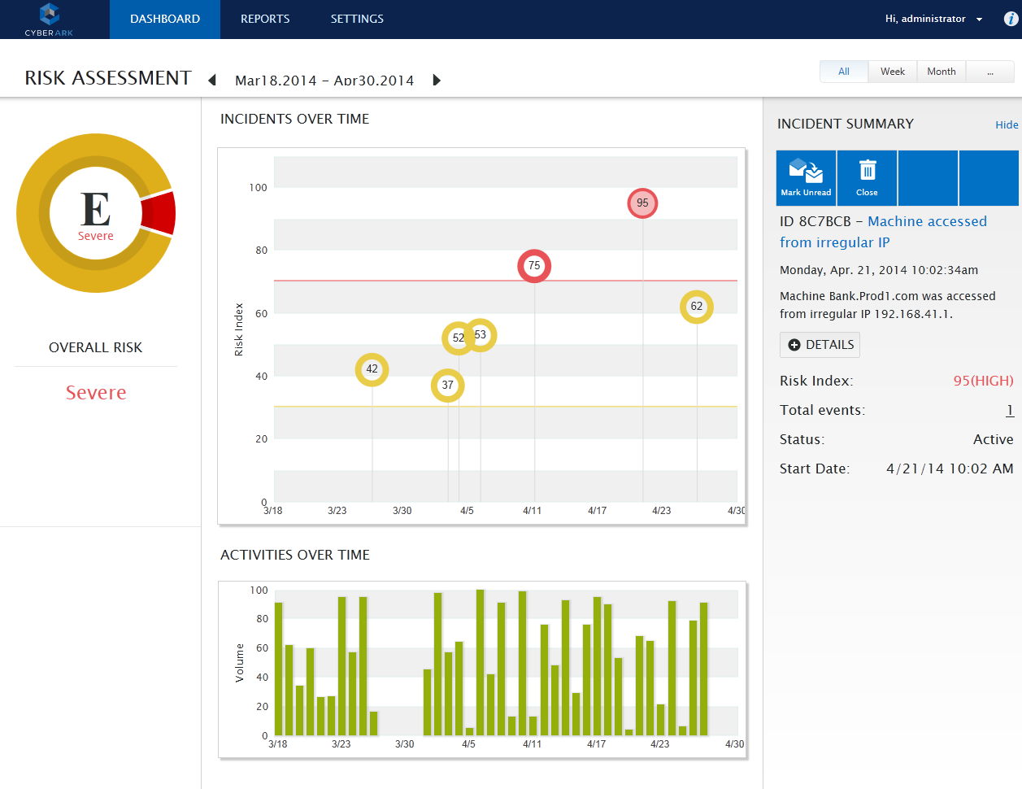
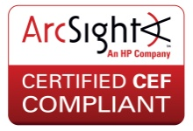





PRIVILEGED THREAT ANALYTICS with
Domain Controller Protection Option
Behavioral Analysis &
Deep Packet Inspection
Normal
PRIVILEGED ACCOUNT ACTIVITY
Network Tap
Authentication Activity
Privileged Threat Analytics
Abnormal
CyberArk Vault & PTA DC agent
Privileged User Activity
SIEM Solution
ALERT: SIEM & CyberArk
Critical System Access
Golden ticket detected
Minimalizuje čas, kdy se útočník snaží zneužít privilegoané přístupy
Odhalí a upozorní na zneužití privilegovaných přístupů v reálném čase – detekce útoků na zranitelnosti Kerberos, kompromitaci přístupů, nestandardní chování uživatele
Notes:
Privileged Threat Analytics analyzes a variety of a data points related to privileged user and account activity to establish a baseline of what’s “normal,” and uses that baseline to easily detect anomalous activity that may indicate in-progress attack. This type of threat detection is a critical component of a privileged account security strategy because once a privileged credential is compromised, the attacker is able to operate under the guise of an authorized user. At that point, they can easily evade network defenses to stay hidden, despite other protections in place. Lets see this in action
(CLICK)
PTA collects authentication data via network taps, privileged user data via the CyberArk Vault and domain controller attacks via the PTA DC agent, as well as account access data from critical systems via SIEM solutions.
(CLICK)
PTA then conducts behavioral analysis and deep packet inspection to assess authentication events and determine if an action is normal or abnormal. Normal activities proceed as is, and are simply logged by the relevant systems. Abnormal activities trigger an alert that is sent to both CyberArk’s threat analytics dashboard and the organization’s SIEM solution so that administrators can investigate the anomalous activity. Alerts on potentially compromised passwords can also be sent back to Enterprise Password Vault to trigger an automatic password update. This invalidates a credential that may be in use by an attacker, helping to automatically containing a theat.
(CLICK)
Questions to ask when discussing PTA with a prospect include:
How you be impacted if targeted attackers operated freely inside your network for months?
How are you currently able to detect advanced attack methods, such as pass-the-hash or golden ticket attacks? These types of attack techniques can provide attackers with administrative access to entire domain, allowing attackers to use valid credentials to scour the network looking for data, learning your systems and slowly stealing your sensitive information.

Slide 17
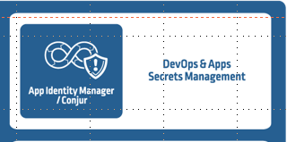
APPLICATION IDENTITY MANAGER
Applications
Enterprise Resources
Type | System
Accounts Receivable
CRM
Human Resources
Online Booking System
WebSphere
Servers
Mainframes
AFTER:
UserName = GetUserName()
Password = GetPassword()
Host = GetHost()
ConnectDatabase(Host, UserName, Password)
WebLogic
BEFORE:
Databases
Applications
UserName = “app”
Password = “y7qeF$1”
Host = “10.10.3.56”
ConnectDatabase(Host, UserName, Password)
Eliminuje riziko hard-coded credentials v aplikacích
Poskytuje flexibilní možnosti vynucení bezpečnostní politiky pro širokou škálu aplikačních/servisních účtů
IIS / .NET
Network Devices
Security Appliances
Legacy /
Homegrown
Websites/ Web Apps
Cloud Infrastructure
Notes:
To understand the value of Application Identity Manager or AIM, let’s first look at a before scenario without AIM. (CLICK)
As applications need to connect to systems for processes such as automated file transfers, web transactions, or vulnerability scans, they must first authenticate to those systems. By default, many of these connections are authenticated using credentials that are hard-coded or embedded into scripts. As a result, anyone inside the network could potentially view the scripts, learn the credentials and use those credentials to gain unauthorized access to sensitive systems.
(CLICK) Application Identity Manager replaces these hard-coded, embedded credentials with a script to retrieve secure, dynamic credentials from the Digital Vault. As a request comes in, CyberArk analyzes the application fingerprint to strongly authenticate the application before providing the credential. Because credentials are stored in the Digital Vault, they can be controlled and rotated, just as user passwords and SSH keys. For business critical applications, such as those necessary in e-commerce infrastructure, credentials can be securely cached and encrypted on local machines to ensure that they are always available. To simply the deployment of this solution, CyberArk integrates out of the box with variety of Commercial off the Shelf Technology, including vulnerability scanners and devops tools.
(CLICK) Questions to ask when discussing AIM with a prospect include:
What would happen if compromised application credentials were used to disrupt critical business processes?
How do you secure sensitive credentials used in applications and scripts?

Slide 18



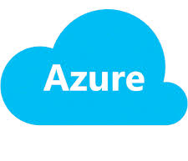




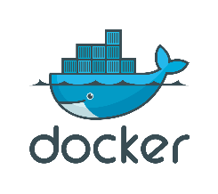
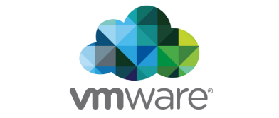









Conjur & CONJUR ENTERPRISE
Code
Integrate
Release
Build
Test
Deploy
Business Owner
Security owner
Ops
Developer
Správa a zabezpečení hesel a secrets v prostředí DevOps
Poskytuje platformu pro správu přihlašovacích údaju pro containerizaci
Umožňuje snadnou integraci s Enterprise Password Vault, DevOps nástroji, ADLDAP a SIEM
Dvě možnosti nasazení: open source software a Enterprise verze
Notes:
Conjur comes in two flavors, an open source free version and Enterprise version that is licensed.
At the core of Conjur is a platform for secrets management of Devops practices
There is a separate training specifically on enabling the team for learning how to sell and what we sell into DevOps with Conjur.
For our purposes here lets just call out that there are needs to prevent security islands and embedded secrets sprawl from occurring across this process. This consists of:
Securing access for privileged users and remote
Maintain Segregation of Duties & Enforcement of least privileges
Generate & maintain secured audit trails
Securing Automated Configuration Management
Secure secrets for CI/CD tools
Securing Automation and Provisioning Processes
Securing of Cloud Infrastructure
Secure secrets for homegrown/COTS applications & scripts
Securing Applications running in containers (Docker), EC2, VMs, …
Now that we identified the problem areas within DevOps, let’s analyze the key challenges in securing the DevOps pipeline
Let’s try to split the pipeline and analyze the different aspects of it:
1. There are the personas that are influencing/contributing/driving the pipeline – well, it’s important to monitor them, it’s crucial to allow them to do their work seamlessly but without opening security holes
2. There are many tools (read too many to list) that are being used during the pipeline. These are tools that a good solution should integrate well with and provide means to secure them
3. Eventually the pipeline produces applications that are installed on images or containers both the application and the underlying infrastructure should be secured as well
This pipeline orchestration of tools and process needs to be protected end to end otherwise the old adage that you are only as strong as your weakest link becomes your reality (a great example is the Uber breach)
(CLICK)
Questions to ask when discussing Conjur with a prospect include:
How are you securing the secrets and credentials used in your DevOps environment?
Are you including coverage across dynamically scaling infrastructure and container based environments?
How are you securing the admin consoles for the multiple tools (Puppet, Ansible, etc.) that support your CI/CD pipeline?
Do you want to leverage existing investments and consistently manage security and access policies across your entire enterprise regardless of the compute and development environments with a seamless security solution?
<click>

Slide 19



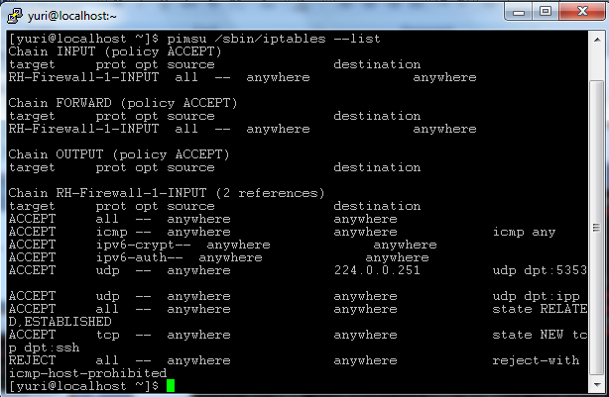
ON-DEMAND PRIVILEGES MANAGER
1. Elevated privilege request sent
Target Resources
2. Authenticate user
3. Validate policy
RHEL
AIX
4. One-time access granted
Solaris
SUSE
User Privileges:
Standard privileges
Permitted elevated privileges
Blocked privileges
Vynucení tzv. least privilege politik – zajistí dostatečná oprávnění pro vyžadovanou činnost a zároveň zabezpečení cílového systému
Splňuje compliance požadavky – auditní záznam, správa privilegovaných přístupů, oddělení rolí
Notes:
On-Demand Privileges Manager enables organizations to centrally create and enforce least privilege policies for Unix and Linux users. Instead of relying on native tools that must be configured on each individual machine, OPM enables organizations control least privilege policies from a single location.
Using OPM, organizations can define what privileges a user may always have to complete day-to-day tasks, they can define which privileges a user may sometimes have, and which privileges a user may never have. In practice, OPM helps organization effectively whitelist, blacklist and greylist specific commands. Let’s look at how it works.
(CLICK) When a user logs into a target Unix or Linux system, he may need to a run a command that requires elevated privileges. Without OPM in place he would typically elevate to root (the super user on the machines) and complete the necessary tasks. The trouble is, as root, the user can carry out a variety of potentially destructive commands then go into the system logs and delete the evidence.
That is not the case with OPM. Instead, if the user needs to run an elevated command, (CLICK) he requests permission from CyberArk for that specific task.
(CLICK) CyberArk then authenticates the user
(CLICK) and checks the least privilege policy.
(CLICK) If the command is pre-approved for one-time purposes, the user is granted temporary elevated privileges, and all activity during the elevated session is recorded and stored in the Digital Vault to prevent tampering.
(CLICK) Questions to ask when discussing OPM with a prospect include:
How do you centrally control user privileges on Linux and Unix systems?
How do you reliably audit root user activity?
How do you prevent root users from editing their audit trails?

Slide 20
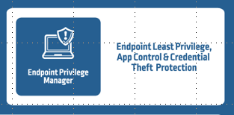
ENDPOINT PRIVILEGE MANAGER
Uzamčení privilegií na Windows a Mac stanicích a serverech – zabrání útoku ihned v prvopočátku
+
+
Privilege management
Application control
Credential theft protection
Odstranění práv lokálního administrátora pro uživatele
Automatické politiky pro povyšování práv a whitelisting
Oddělení oprávnění na Windows Serverech
Blokuje nevyžádané aplikace
Automaticky povýší oprávnění pro vybrané aplikace
Zabrání neznámým aplikacím způsobit škodu
Detekuje a blokuje odcizení přihlašovacíh údajů na Windows stanicích
Chrání OS, prohlížeče a file cache credential stores
Zabrání vstupu útočníka na stanici
Odstranění práv lokálního administrátora a kontrola aplikací na stanicích a serverech bez zatížení IT a obtěžování uživatelů
Integrace s nástroji na detekci škodlivých kódů a podvodných aplikací
Sledování kdo, kdy a odkud spouští které aplikace a soubory
Notes:
Endpoint Privilege Manager combines three technologies to lock down privilege on the endpoint and contain attacks early in their lifecycle. Let’s take a closer look at each of them.
(CLICK)
The first is privilege management. As you’ve already learned, local admin rights can be used to accidentally or intentionally cause damage, so one of the best things an organization can do to reduce the attack surface is to remove local admin rights from standard users. CyberArk Endpoint Privilege Manager enables organizations to remove local admin rights from standard business users as well as control command line activity on endpoints. The solution can also be deployed on Windows Servers to help organization segregate administrative duties based on role. From an endpoint perspective, while removing local admin right helps to dramatically reduce the attack surface, it can also come with operational and productivity tradeoffs, as users are forced to call the help desk whenever they need access to an application the requires local admin privileges.
(CLICK)
This is where application control comes. Endpoint Privilege Manager enables organizations to set privilege policies at the application level so that authorized applications that require local admin rights can run properly – without having to give users full local admin access. Application controls block malicious applications from running; elevate privileges for known, trusted applications as needed; and enable unknown applications, which are neither explicitly trusted nor untrusted, to run in a restricted way so that they cannot inflict damage.
(CLICK)
Lastly, credential theft protection helps organizations detect and block suspected credential theft at the endpoint, minimizing the risk of privilege escalation and lateral movement using compromised credentials.
(CLICK) When talking to prospects about Endpoint Privilege Manager, questions to ask include:
How do you remove local admin rights while keeping users happy and limiting IT support costs?
How do you contain the spread of malware to reduce remediation time and effort?
How do you enable only trusted applications to run without draining resources and reducing productivity?

Slide 21

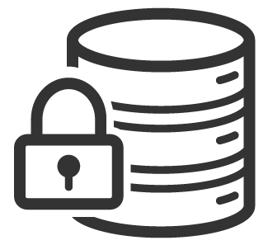

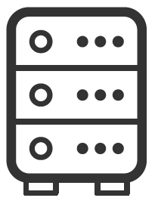
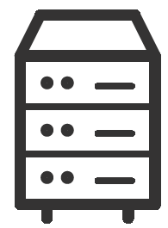
Standard Cyberark architecture
USER
PVWA LOAD BALANCING
PVWA LOAD BALANCING
PVWA
PVWA
PVWA
PVWA
BACKUP
DR VAULT
PRIMARY VAULT
SATELLITE VAULT
PSM DR
CPM DR
PSM1
CPM1
PSM2
CPM2
TARGET DEVICES
TARGET DEVICES
TARGET DEVICES
Disaster recovery site
SITE 1
SITE 2

Slide 22
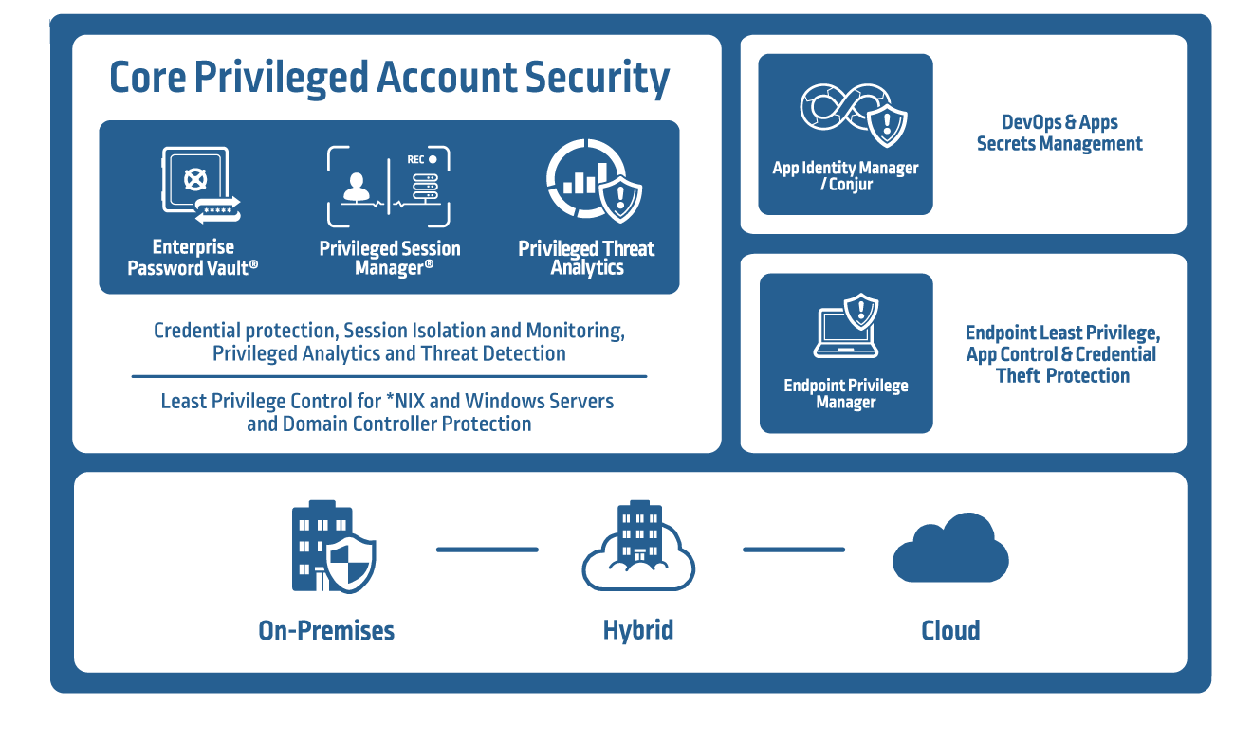
Cyberark privileged account security solution
Notes:
CyberArk’s Privileged Account Security Solution is packaged with a core component and two add-on modules to the core.
The complete solution includes seven integrated products that work together to deliver robust security of privileged accounts. The products are developed in multiple streams with agile methodologies in mind and are tested with a hackers mindset, strongly backed by our own CyberArk Labs researchers that try to hack our own software and find ways to circumvent our protections.
At the core of these products is the Shared Technology Platform, which serves as a the common infrastructure for the products within the Privileged Account Security portfolio.
Products within the portfolio include:
Core Privileged Account Security:
Secures, rotates and controls access to privileged account credentials such as passwords and SSH Keys
Secures privileged sessions to protect sensitive target systems and enables live monitoring and recording of privileged user session
Profiles and analyzes privileged user and account behavior and creates prioritized alerts when abnormal activity is detected.
Secure servers with the ability to granular level controls and enforce the principle of least privilege on both *NIX and Windows systems
Secure Domain Controllers to monitor and detect Kerberos attacks
Application Identity Manager, which secures application credentials that are often hardcoded or embedded into applications and scripts
Conjur & Conjur Enterprise, which manages secrets that are often hardcoded or embedded into applications and scripts as part of a DevOps pipeline which are highly dynamic
Endpoint Privilege Manager, which helps organizations minimize local administrative privileges, control applications on endpoints and detect and block suspected credential theft at the endpoint
All together, this portfolio of products delivers a single solution that delivers the broadest enterprise-ready privileged account security available today.
<click>

Slide 23
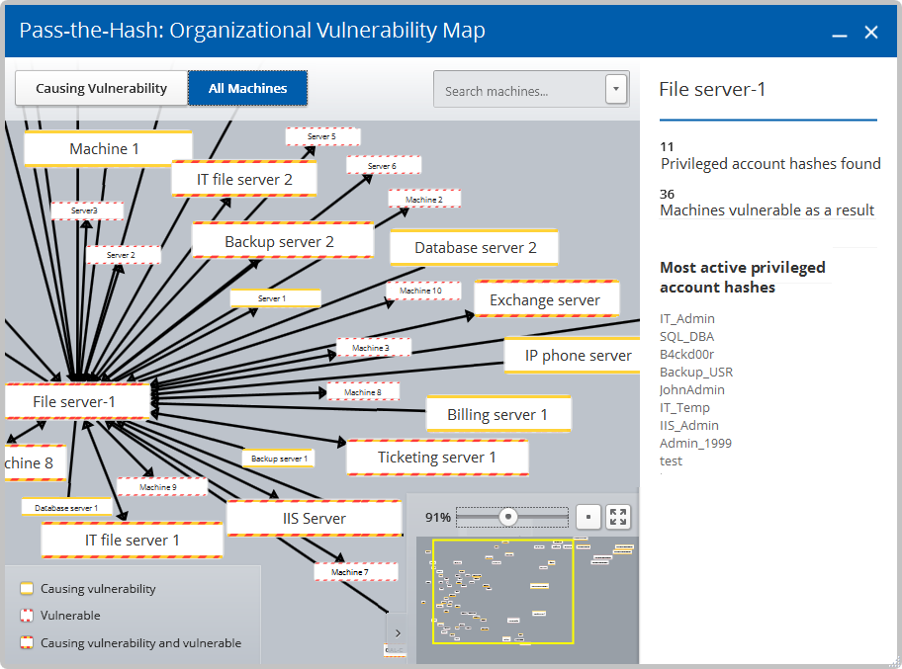
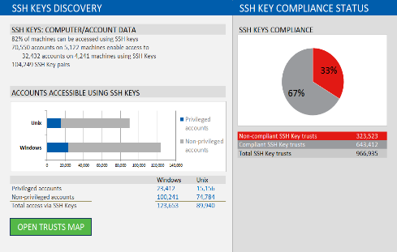
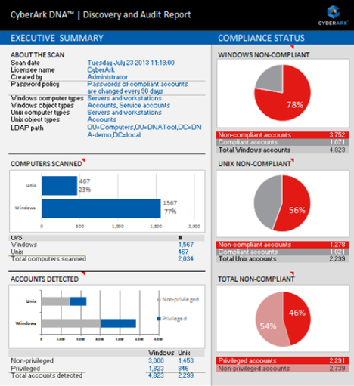
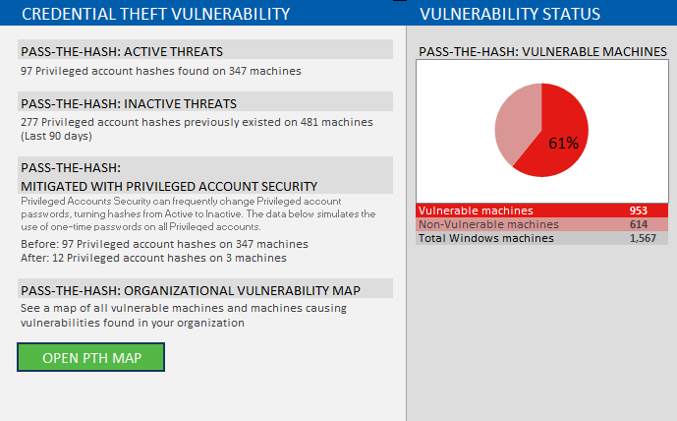
CyberArk Discovery & Audit (DNA)
Vyhledá všechny účty (privilegované i standardní)
Identifikuje privilegované účty a typ přihlašování:
  SSH klíče
  Vložené/hard-coded účty na IIS/WebSphere/WebLogic
  Nezabezpečené užívaní práv na UNIX systémech
  Hashe hesel na stanicích a serverech
  AWS IAM uživatele, Access Keys a EC2 Key pairs
  Riziko Golden Ticket attack
Přehledné reporty s výsledky skenu -
Executive Summary Dashboard
Vytvoření tzv. Trust map s vyhledanými SSH klíči a hash hesel
Sken běží v pozadí s minimálním dopadem na výkon
Aplikace se neinstaluje (spustitelný exe soubor)
Nízké nároky na výkon

Slide 24
DĚKUJI

